Slide 1
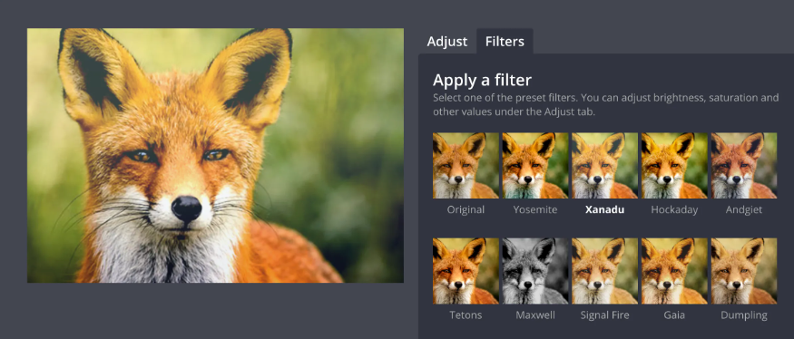
Convolution Core Implementation
Prepared & Presented By: Habiba Hassan
Norhan Abdelhamid & Reem Mohamed

Slide 2
Full System Components
System Controller
Full System Block Diagram
05
01
Queue Memory (Input & Kernel)
Full System Block Diagram
02
06
Floating Point Multiplier
FIFO (Cyclic Queue)
03
07
Floating Point Adder & Accumulator
FIFO Controller
04
08
Integrated System Results
09

Slide 3
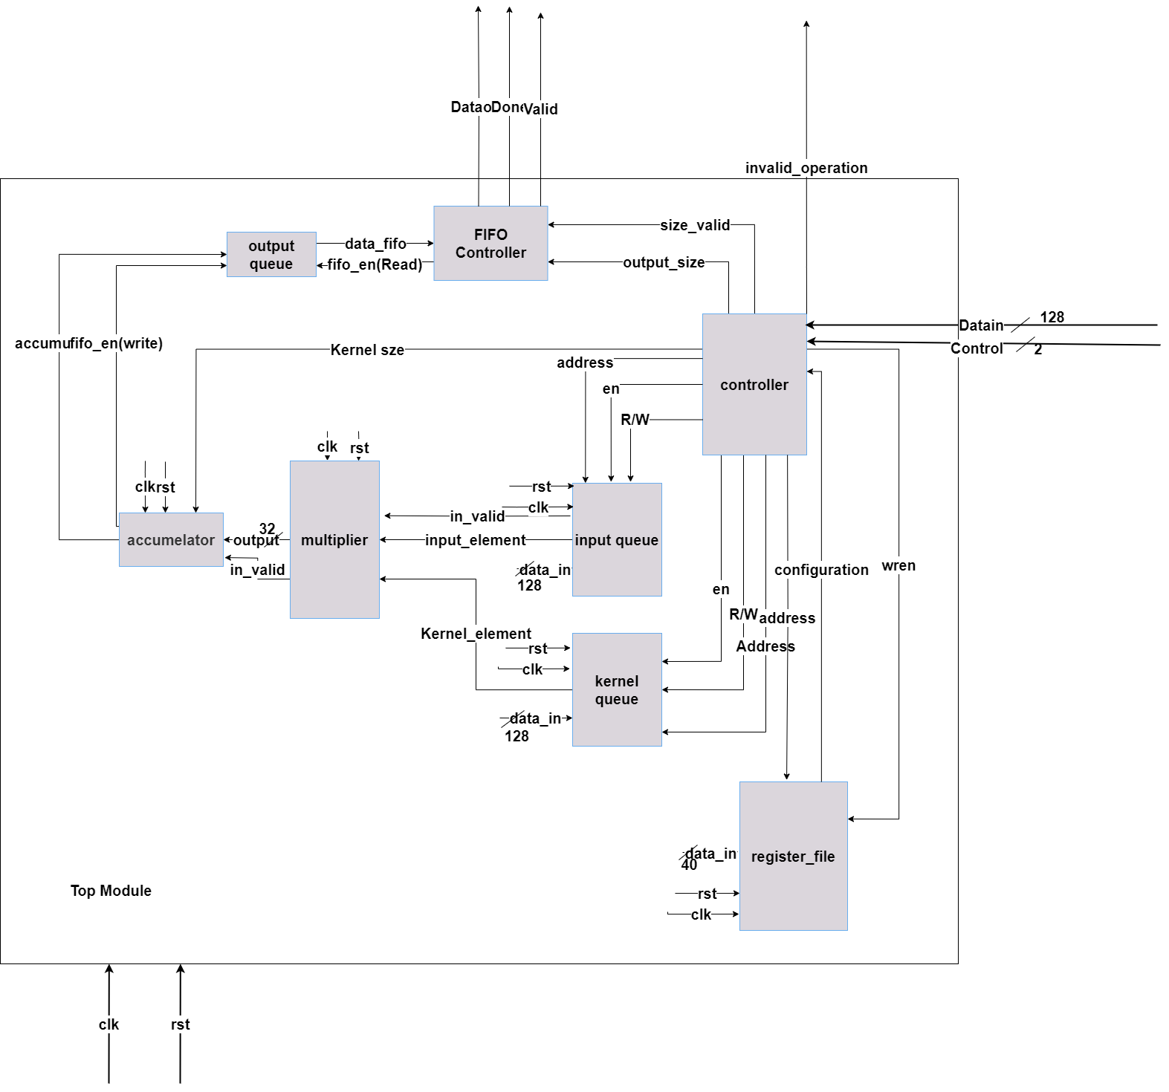
Full System Block Diagram

Slide 4

Full Block Diagram Signals
Signal | Direction | Width | Description
clk | Input | 1 | System Clock
rst | Input | 1 | System Reset
Datain | Input | 128 | Input Data (kernel or picture or config)
control | Input | 2 | Identifies Process (load config-load in-load kernel-compute)
Done | Output | 1 | Full Process Done
valid | Output | 1 | Output data available on bus
Dataout | Output | 128 | Output Data

Slide 5
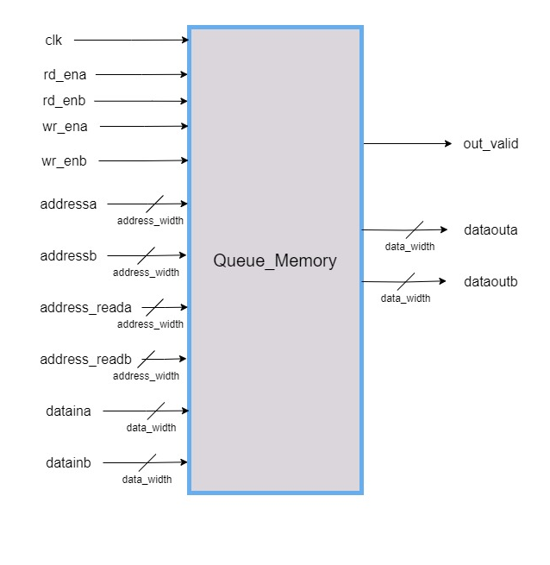
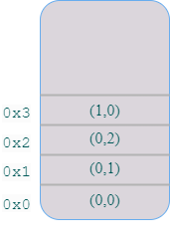
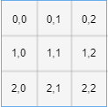
Queue Memory Interface

Slide 6
Memory Signals
Signal | Direction | Width | Description
clk | Input | 1 | System Clock
rd_ena | Input | 1 | Read Enable Signal (Port A)
rd_enb | Input | 1 | Read Enable Signal (Port B)
wr_ena | Input | 1 | Write Enable Signal (Port A)
wr_enb | Input | 1 | Write Enable Signal (Port B)
addressa [0:3] | Input | address_width | Addresses To Save In Data (Port A)
addressb [0:3] | Input | address_width | Addresses To Save In Data (Port B)
Datain_a [0:3] | Input | 32 | Data To be Saved in Memory (Port A)
Datain_b [0:3] | Input | 32 | Data To be Saved in Memory (Port B)
Dataouta | Input | 32 | Data To Read From Memory (Port A)
Dataoutb | Input | 32 | Data To Read From Memory (Port B)

Slide 7
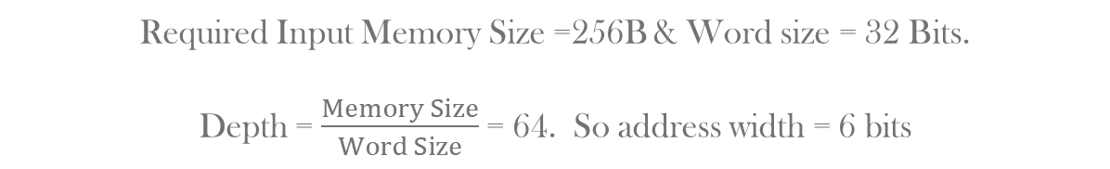
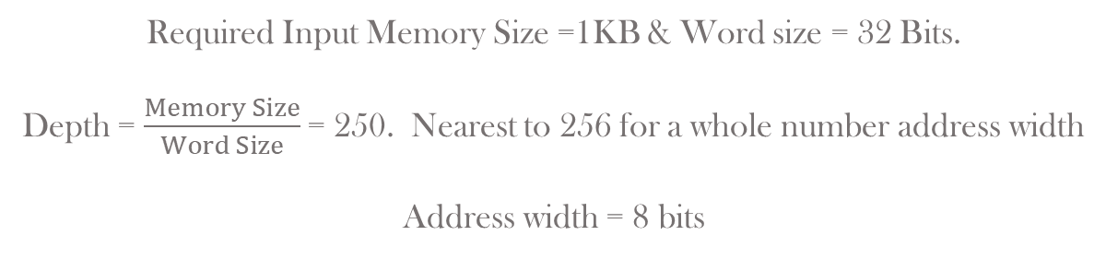
Input Memory Calculations
Required Input Memory Size =1KB & Word size = 32 Bits.
Depth = $\frac{Memory Size}{Word Size}$= 250. Nearest to 256 for a whole number address width
Address width = 8 bits
Kernel Memory Calculations
Required Input Memory Size =256B & Word size = 32 Bits.
Depth = $\frac{Memory Size}{Word Size}$= 64. So address width = 6 bits

Slide 8
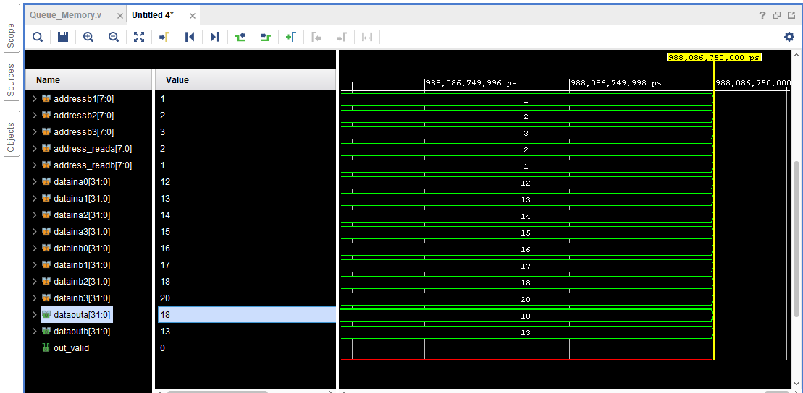
Test Scenarios for Dual Port RAM
writing from Port A
writing from Port B
Reading from Port B
Reading from Port A

Slide 9
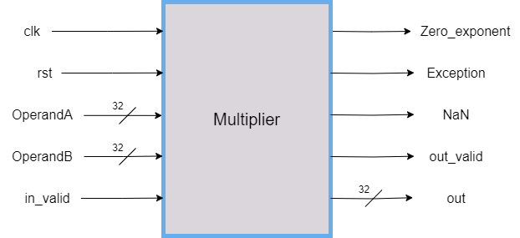
Floating Point Multiplier Interface

Slide 10
Floating Point Multiplier Signals
Signal | Direction | Width | Description
clk | Input | 1 | System Clock
rst | Input | 1 | Reset Module
OperandA | Input | 32 | Floating Input Element
OperandB | Input | 32 | Floating Kernel Element
In_Valid | Input | 1 | Numbers ready for multiplication
Zero_Exponent | Output | 1 | One or both exponents = 0
Exception | Output | 1 | Output = infinity
NAN | Output | 1 | Output = NAN
Out_Valid | Output | 1 | Enable Accumulator
Out | Output | 32 | Multiplication Result

Slide 11
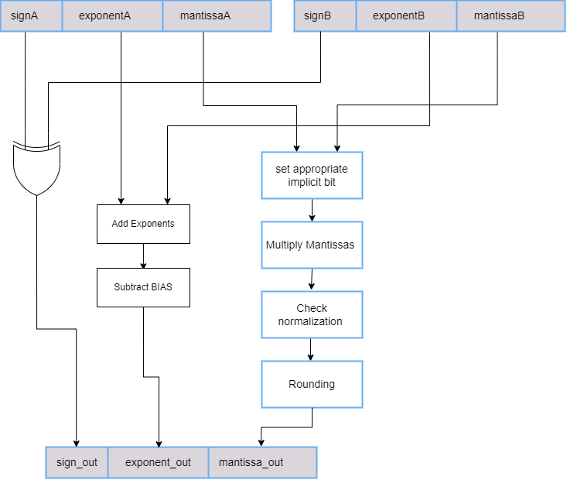
Floating Point Multiplier Operation

Slide 12
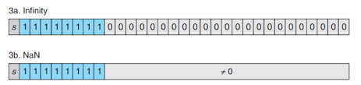
Floating Point Multiplier Testing
Self-checking Testbench using golden model
Test is made using random data for OperandA and OperandB
Some directive test cases are made to test special cases like:
Exception
NAN
Zero Mantissas
Zero Exponent

Slide 13
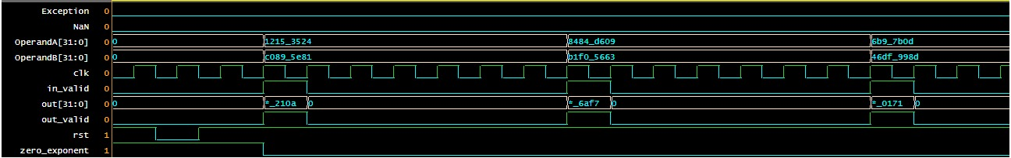

Simulation Results
Transcript Report

Slide 14
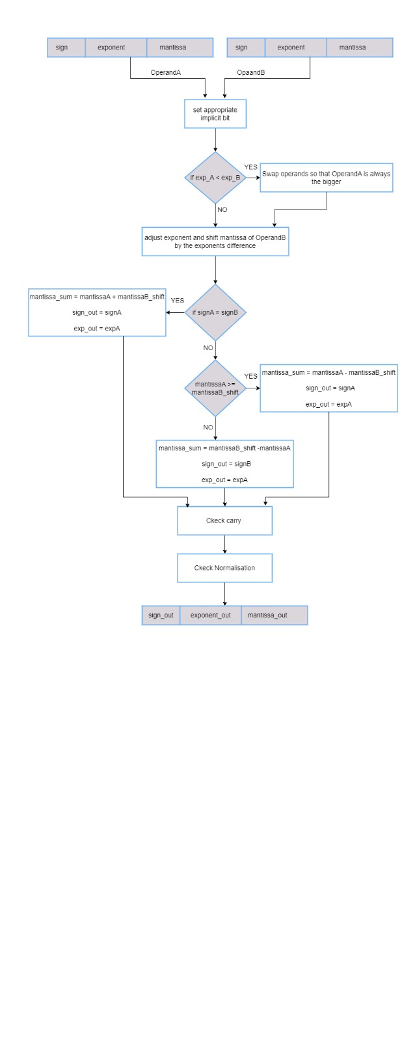

Floating Point Adder

Slide 15
Floating Point Adder Signals
Signal | Direction | Width | Description
clk | Input | 1 | System Clock
rst | Input | 1 | Reset Module
OperandA | Input | 32 | Multiplier Output
OperandB | Input | 32 | Last Accumulated Result
In_Valid | Input | 1 | Enable Adder
Exception | Output | 1 | Output = infinity
NAN | Output | 1 | Output = NAN
Out_Valid | Output | 1 | Result Ready
Out | Output | 32 | Addition Result

Slide 16
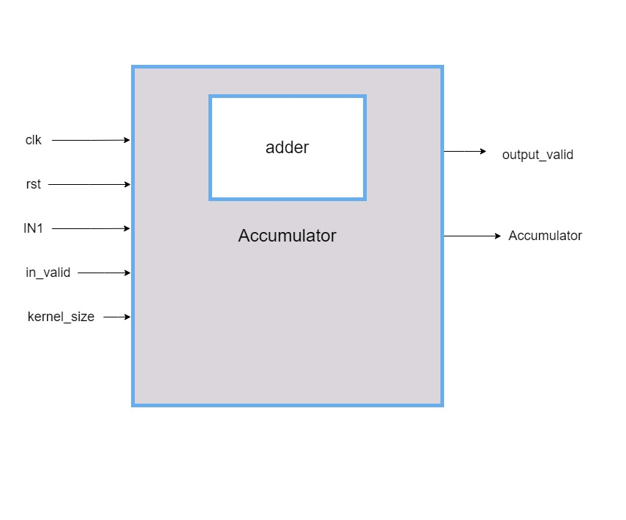
Floating Point Accumulator Interface

Slide 17
Floating Point Accumulator Signals
Signal | Direction | Width | Description
clk | Input | 1 | System Clock
rst | Input | 1 | Reset Module
IN1 | Input | 32 | Multiplier Output
In_Valid | Input | 1 | Enable Accumulator (Hence adder)
Kernel_Size | Output | 8 | Gets number of kernel elements to generate one output element
Accumulator | Output | 32 | Accumulator Ouput
Out_Valid | Output | 1 | FIFO Enable

Slide 18

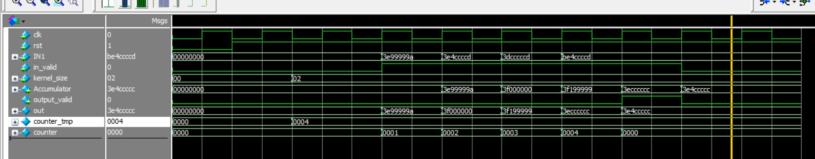
Floating Point Accumulator Testing
Simulator Results
Test case of kernel Size 2
Accumulating both positive and negative inputs

Slide 19
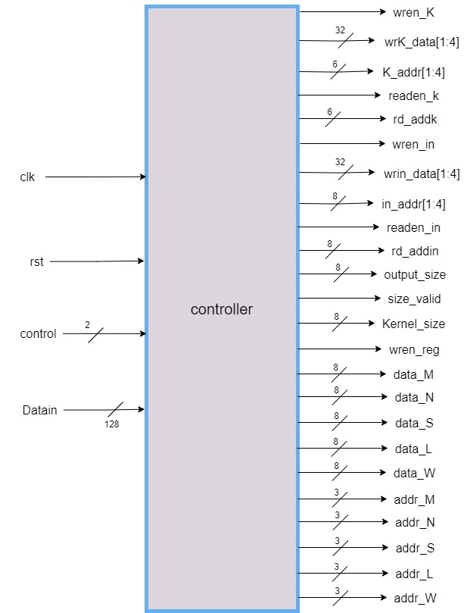
Controller Interface

Slide 20
Controller Signals
Signal | Direction | Width | Description
clk | Input | 1 | System Clock
rst | Input | 1 | Reset System
Control | Input | 2 | Identifies Process (load config-load in-load kernel-compute)
Datain | Input | 128 | Input Data (kernel or picture or config)
wren_k | Output | 1 | Enable writing in kernel memory
wrk_data [1:4] | Output | 32 | Data to be loaded in kernel memory
k_addr [1:4] | Output | 6 | Address of loaded data in kernel memory
Readen_k | Output | 1 | Enables reading from kernel
Rd_addk | Output | 6 | Address of data to be read

Slide 21
Controller Signals
Signal | Direction | Width | Description
wren_reg | Output | 1 | To enable writing in Register File
data_M | Output | 8 | Number of Kernel Rows
data_N | Output | 8 | Number of Kernel Columns
data_S | Output | 8 | Stride Length
data_L | Output | 8 | Number of Input Rows
data_W | Output | 8 | Number of Input Columns
addr_M | Output | 3 | Address of register M in Reg File
addr_N | Output | 3 | Address of register N in Reg File
addr_S | Output | 3 | Address of register S in Reg File
addr_L | Output | 3 | Address of register L in Reg File
addr_W | Output | 3 | Address of register W in Reg File

Slide 22
Controller Signals
Signal | Direction | Width | Description
wren_in | Output | 1 | Enable writing in input memory
wrin_data [1:4] | Output | 32 | Data to be loaded in input memory
in_addr [1:4] | Output | 8 | Address of loaded data in input memory
readen_in | Output | 1 | Enables reading from input
rd_addin | Output | 8 | Address of data to be read
output_size | Output | 8 | Gets the size of output matrix (number of elements to be put on output bus)
size_valid | Output | 1 | Confirms whether output size is valid
kernel_size | Output | 8 | The number of rows of kernel. Used to calculate number of kernel elements
Invalid_Operation | Output | 1 | Asserted in case kernel size larger than input size

Slide 23
Controller Explained
Case 00
Case 01
Case 10
Load Input & Kernel Sizes
Controller triggers the load of Kernel Data
Controller triggers the load of Input Data

Slide 24
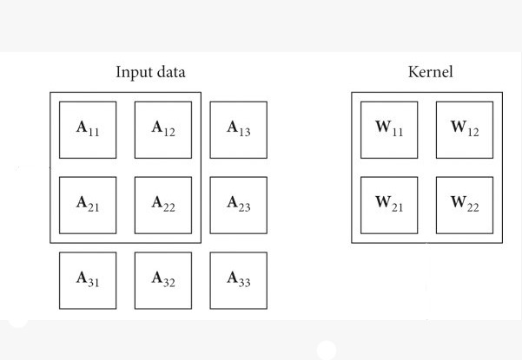
Controller Explained

Slide 25
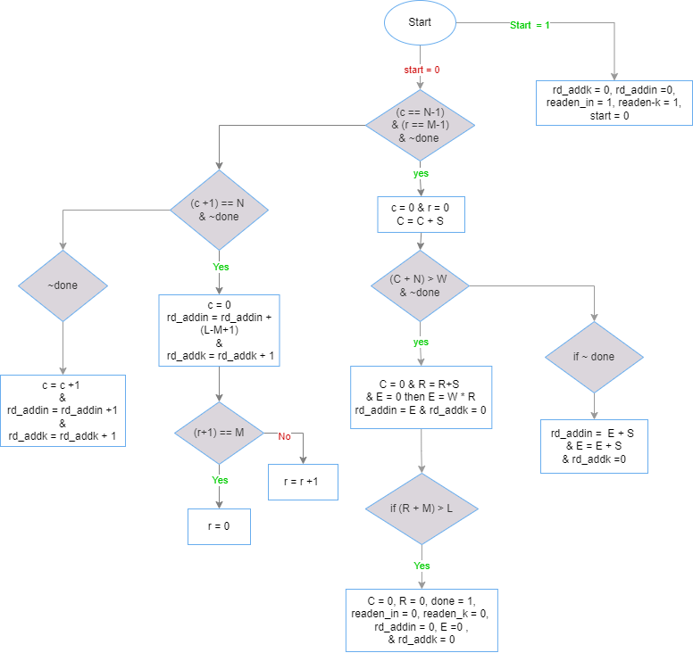
Controller Explained
Case 11

Slide 26
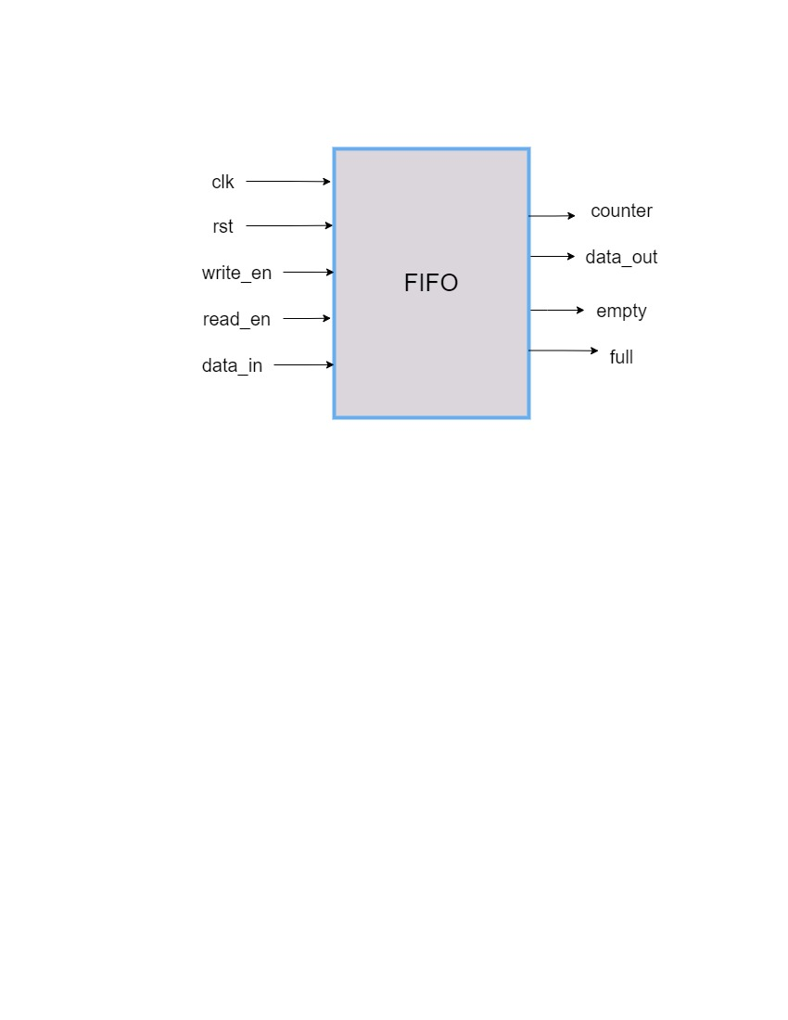
FIFO: Cyclic Queue Memory Interface

Slide 27
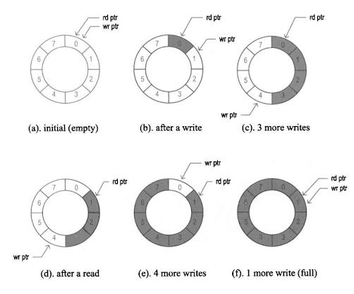
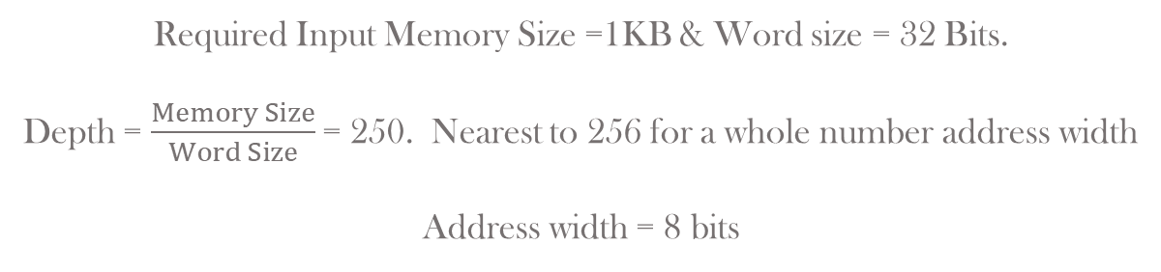
FIFO Calculations
Required Input Memory Size =1KB & Word size = 32 Bits.
Depth = $\frac{Memory Size}{Word Size}$= 250. Nearest to 256 for a whole number address width
Address width = 8 bits

Slide 28
FIFO Signals
Signal | Direction | Width | Description
clk | Input | 1 | System Clock
rst | Input | 1 | Reset Module
write_en | Input | 1 | Enable Writing in FIFO
read_en | Input | 1 | Enable Reading from FIFO
data_in | Input | 32 | Accumulator Output
data_out | Output | 1 | One Element of Output
counter | Output | 8 | Indicator for Filled FIFO Locations
empty | Output | 1 | Flag for Empty FIFO
full | Output | 32 | Flag For Full FIFO

Slide 29
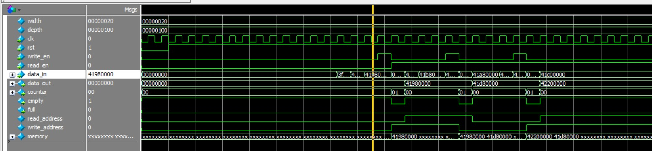
FIFO Testing
Test Scenario: writing & reading from FIFO. Dataout takes its value once the enable is raised. Counter returned to 0 after reading

Slide 30
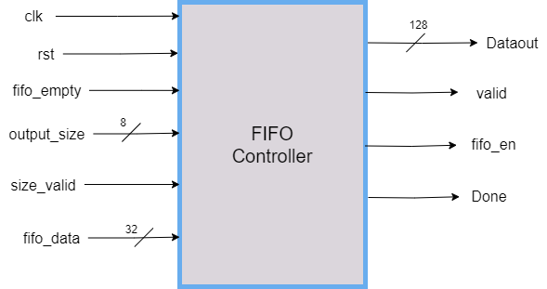
FIFO Controller Interface

Slide 31
FIFO Controller Signals
Signal | Direction | Width | Description
clk | Input | 1 | System Clock
rst | Input | 1 | Reset Module
Fifo_empty | Input | 1 | Flag triggered at Empty FIFO
Output_Size | Input | 8 | Gets number of output elements to generate the full output data bus
Size_Valid | Input | 1 | Confirms whether output size is valid
Fifo_Data | Input | 32 | Data Saved in FIFO
Dataout | Output | 128 | Full output bus
Valid | Output | 1 | asserted when out data is valid (128 bits ready to be out on bus)
Fifo_en | Output | 1 | Enables reading from FIFO
Done | Output | 1 | All output elements generated. Convolution process done

Slide 32
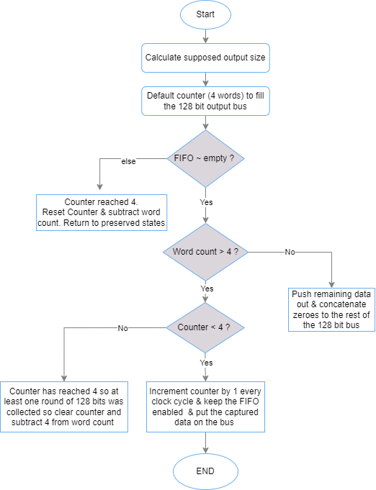
FIFO Controller Explained

Slide 33
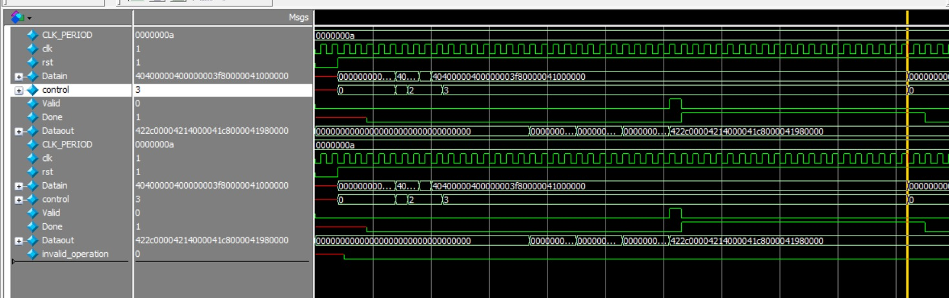
Integration Results
Test Case 1 : input matrix 3x3, Kernel matrix 2x2, Stride = 1

Slide 34
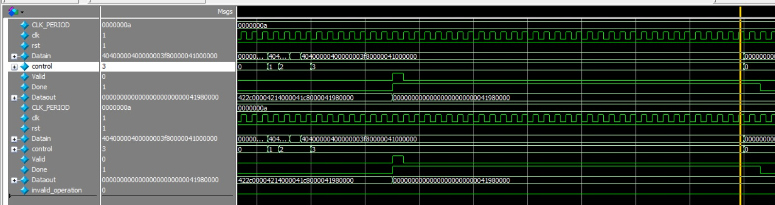
Integration Results
Test Case 2 : input matrix 3x3, Kernel matrix 2x2, Stride = 2

Slide 35
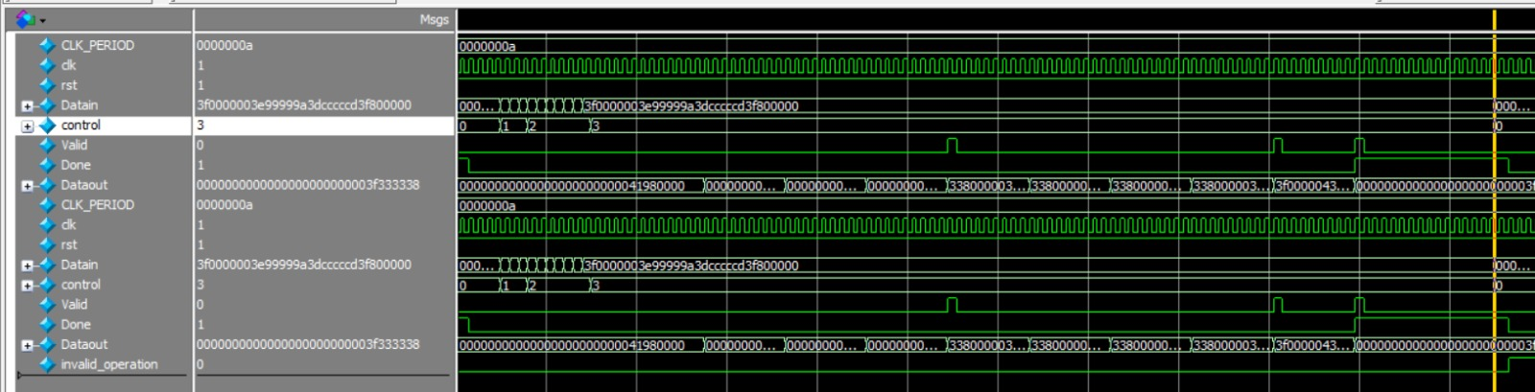
Integration Results
Test Case 3 : input matrix 5x5, Kernel matrix 3x3, Stride = 1 (input floating, Kernel with negative numbers)

Slide 36
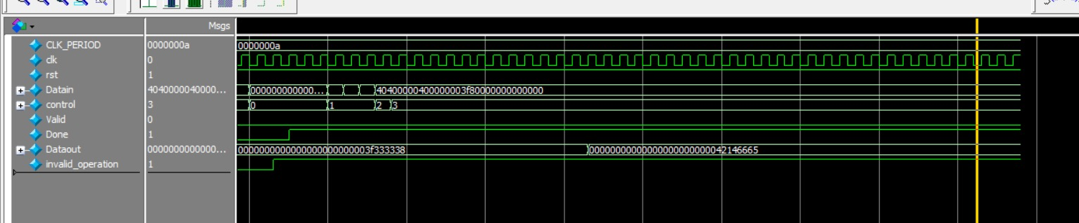
Integration Results
Test Case 4 : testing invalid operation (Kernel matrix larger than input matrix)

Slide 37


